Slide 1
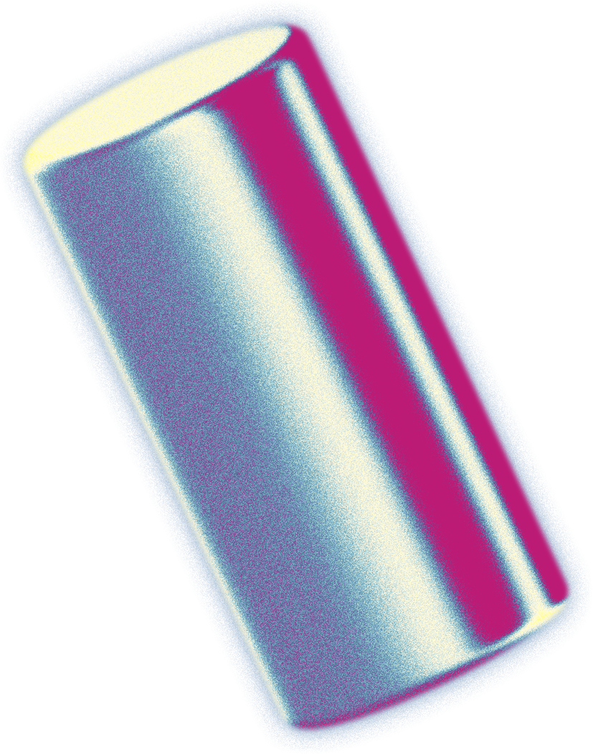
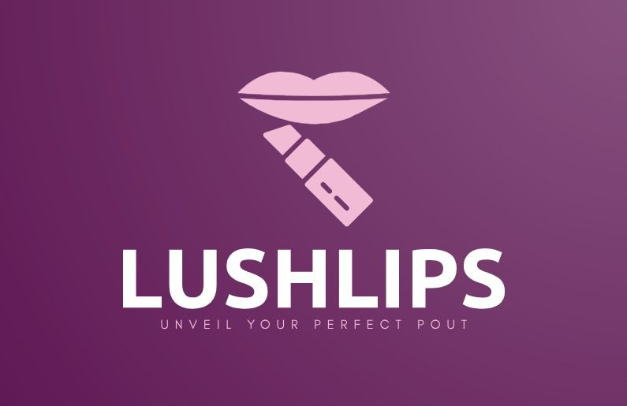


BY - 7. BITCORE
01

Slide 2



LIST OF
CONTENTS
INTRODUCTION
KEY FEATURES
PROJECT DEMO
PROBLEM STATEMENT
BUSINESS MODEL
IMPACT AND BENEFITS
PROPOSED SOLUTION
TECHNOLOGY STACK
FUTURE SCOPE
MARKET OPPORTUNITY
DEVELOPMENT PROCESS
CONCLUSION
02

Slide 3
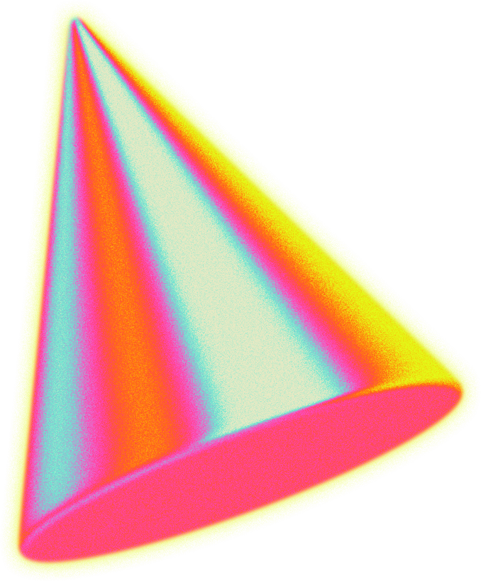
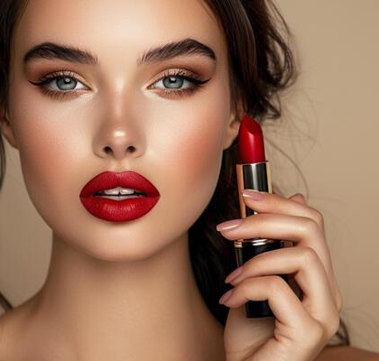

INTRODUCTION
“Where Innovation Meets Elegance”
Lush Lips is a cutting-edge platform combining beauty and technology to redefine the online lipstick shopping experience.
Our AI-powered virtual try-on and shade recommendation tools personalize shopping while promoting vegan, cruelty-free products.
We’re not just selling lipsticks; we’re creating a sustainable and ethical beauty revolution.
03

Slide 4
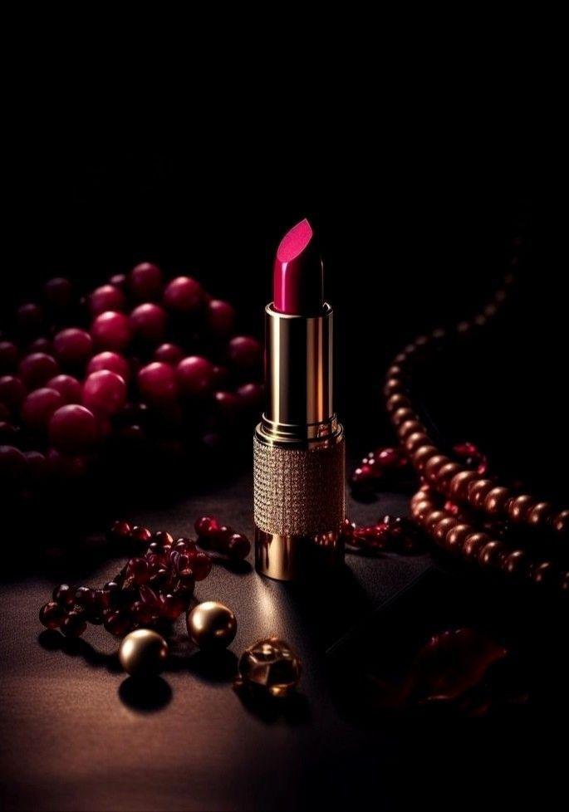
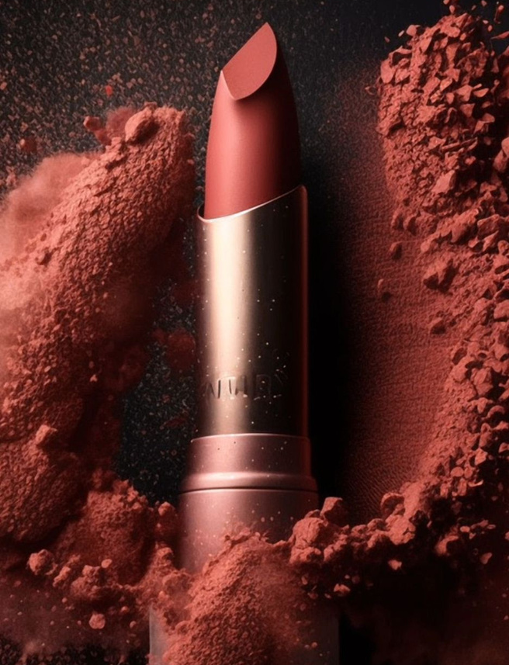
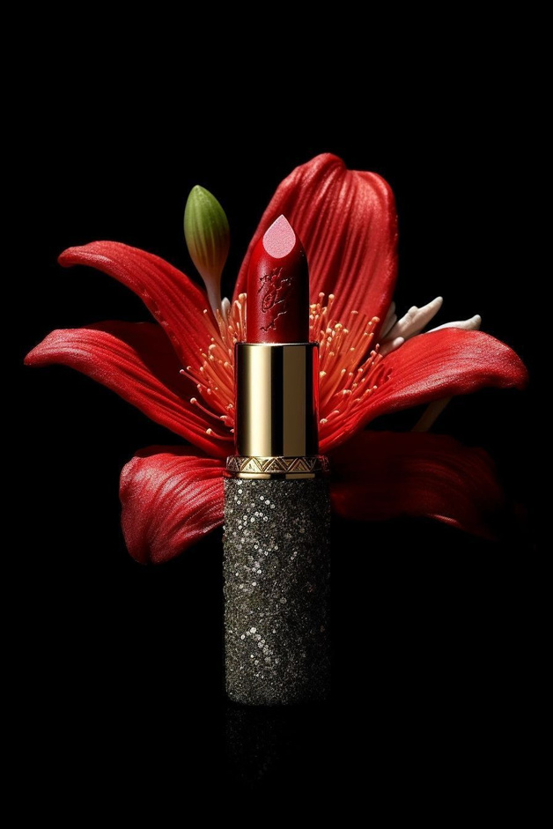
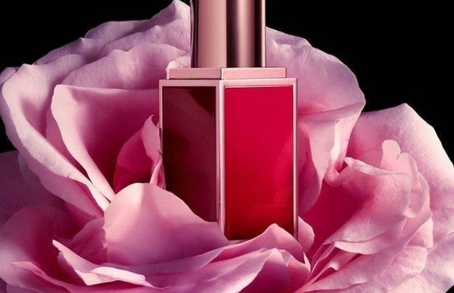
OUR
PRODUCTS
CRIMSON CRUSH
HONEYDEW HAZE
BERRY BLISS
GRAPE GRADIENT
PERFECT MAGENTA
SUNSET ORANGE
LIGHT VELVET
MOCHA MUSE
CLASSIC RED
04

Slide 5
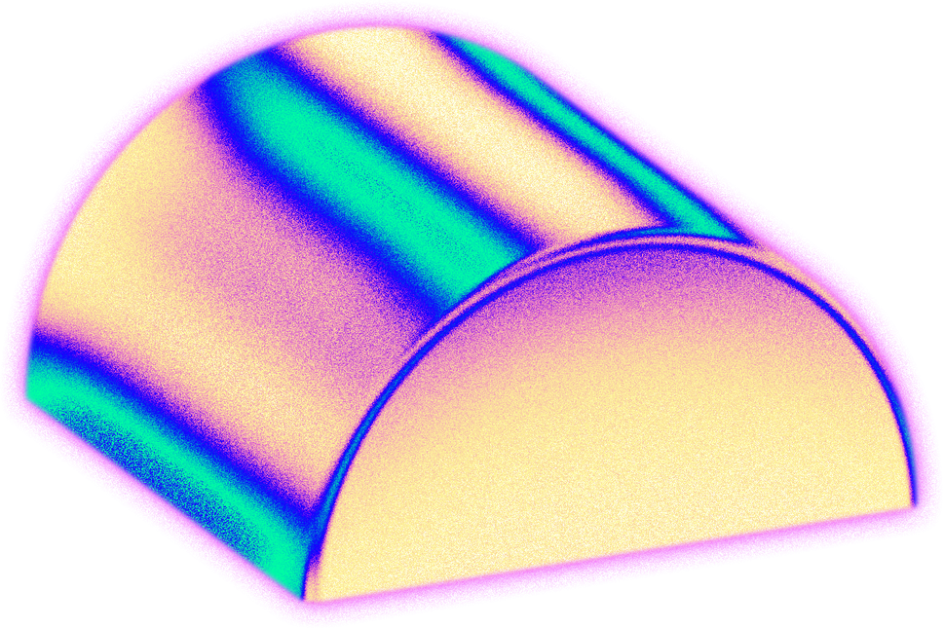
PROBLEM STATEMENT
Consumers face difficulty selecting suitable lipstick shades online without trying them on.
Most brands use harmful ingredients like parabens, carmine, and beeswax, which are neither vegan nor cruelty-free.
.
Lack of personalization in shade selection leads to a disconnected shopping experience - they want some suggestions while shopping.
Environmental concerns over non-sustainable packaging materials.
05

Slide 6
PROPOSED SOLUTION
1
2
3
4
An AI-powered virtual try-on tool enabling users to upload their photos or use live webcams to test shades in real time.
Personalized shade recommendations based on individual skin tones using advanced machine learning.
Emphasis on vegan, cruelty-free lipsticks to align with ethical consumer values.
A competitive analysis tool showcasing why natural lipsticks are superior to chemical-heavy alternatives.
06

Slide 7
DEMAND FOR BETTER INGREDIENTS
Consumers are increasingly prioritizing beauty products that are vegan, cruelty-free, and made from sustainable ingredients. Harmful chemicals in conventional products are driving a shift toward ethical and clean alternatives.
MARKET
OPPORTUNITY
INNOVATION IN E-COMMERCE
Why Lush Lips is a Game Changer
Online beauty product sales have surged post-pandemic, but few platforms truly address the lack of personalization in the digital shopping experience. With Lush Lips, we are not just selling products,we’re offering a seamless, & engaging solution.
07

Slide 8

KEY FEATURES
What Makes Lush Lips Stand Out?
VIRTUAL TRY-ON
SHADE RECOMMENDATIONS
Real-time AR experience to test lipstick shades.
Tailored suggestions based on skin tone analysis.
SUSTAINABLE PACKAGING
Eco-friendly materials for all lipsticks.
08

Slide 9
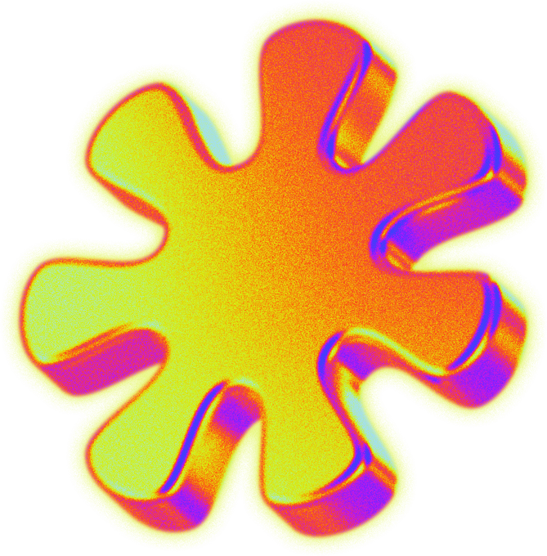
BUSINESS MODEL
REVENUE STREAMS
TARGET CUSTOMERS
REQUIRED INVESTMENT
Lipstick Sales
Beauty enthusiasts
₹41,50,00 (50%) for technology upgrades
₹24,90,00 (30%) for marketing
Brand Partnerships:
Ethical shoppers
Affiliate Marketing
Millennials and Gen Z
₹16,60,00 (20%) for inventory.
09

Slide 10
TECHNOLOGY STACK
Technological Foundation of Lush Lips
FRONTEND & BACKEND
MACHINE LEARNING MODEL
HTML,CSS,JS for the web interface and
Django for scalable and secure operations
Python and Randon Forest Classifier for skin tone detection and shade recommendation. MediaPipe for TryOn
DATABASE
APIS
SQLite for customer data storage and AI training datasets.
SEBASTIAN BENNET
Real-time AR implementation via OpenCV
Write a short statement about the consumer's assessment of your product.
10

Slide 11
DEVELOPMENT PROCESS
Technological Foundation of Lush Lips
1
2
3
4
5
Researching market gaps and identifying key customer pain points.
Designing the UI/UX for a smooth virtual try-on and shopping experience.
Training the ML model using labeled datasets of skin tones and lipstick shades.
Building the web app backend and integrating AI algorithms.
Testing extensively to ensure accuracy in shade recommendation.
11

Slide 12
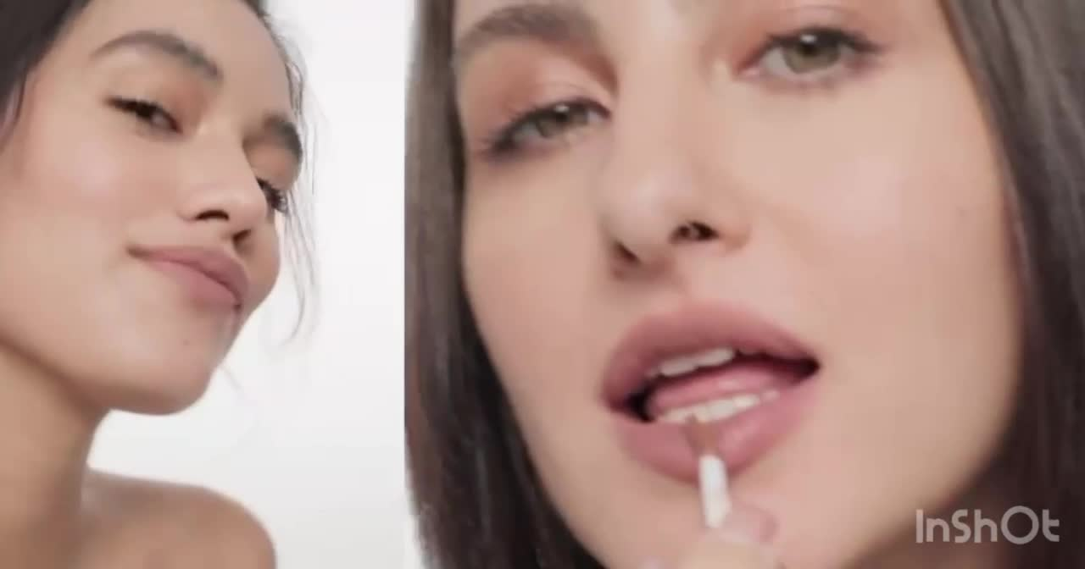
PROJECT DEMO
See LUSHLIPS in Action - LIVE DEMO
12

Slide 13
IMPACT AND BENEFITS
IMPACT
BENEFITS
Revolutionizes how people shop for lipstick by providing personalized, AI-driven recommendations.
Makes ethical and cruelty-free beauty choices accessible to a wider audience.
Promotes sustainable practices with eco-friendly packaging, reducing waste.
Helps set an industry standard for environmentally conscious production.
Seamless and interactive virtual try-on experience.
Confidence in shade selection with skin-tone-based recommendations.
Access to safe, vegan, and cruelty-free products.
Drives awareness about harmful ingredients in traditional products.
Encourages a broader shift toward ethical and sustainable consumption.
13

Slide 14
Expanding the lipstick shade range with localized color preferences.
Incorporating AR filters on social media platforms.
Rolling out global shipping with AI-driven localized recommendations.
Developing partnerships with eco-friendly beauty influencers and content creators.
FUTURE
SCOPE
Expanding the Vision
14

Slide 15
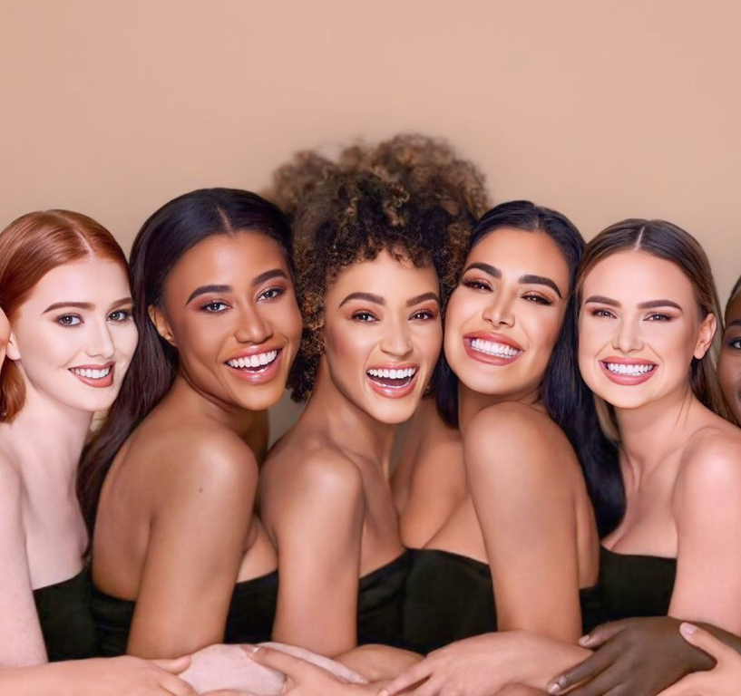
CONCLUSION
Why Lush Lips?
Lush Lips is more than a beauty platform—it's a revolution that combines the power of AI with ethical and sustainable practices to transform how people shop for lipsticks.
By addressing real consumer challenges and introducing innovation through AI-powered virtual try-ons, personalized recommendations, and eco-friendly products, we are setting a new standard in the beauty industry.
15

Slide 16
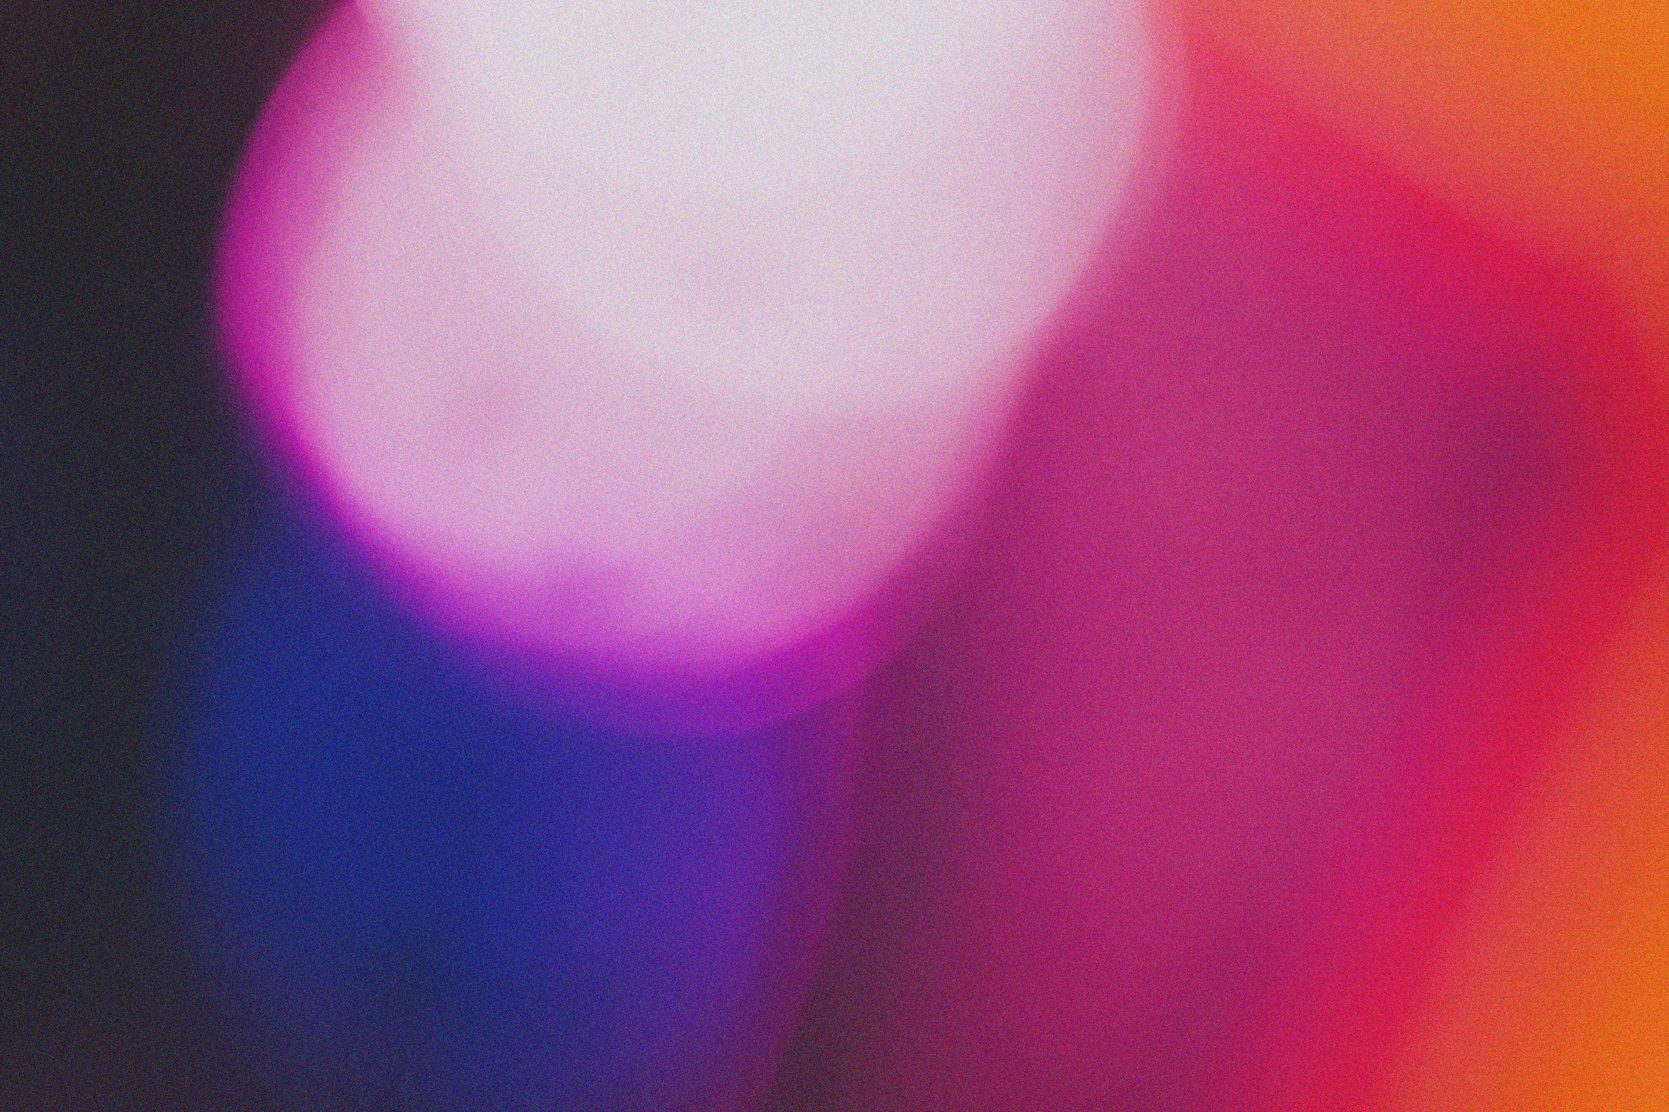
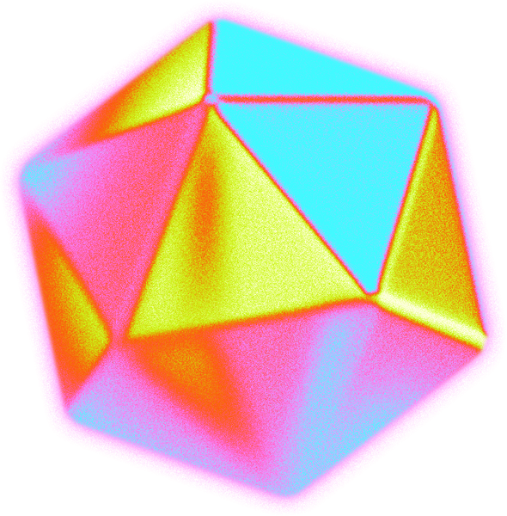
BY - 7. BITCORE
WE GREATLY ANTICIPATE
WORKING WITH YOU
Join the movement toward smarter, ethical beauty solutions.
16

